Slide 1




BE WATER EFFICIENT
FREE CLASS FOR PROFESSIONALS
Sponsored by Bay Area Water Supply & Conservation Agency
QWEL workshop in English
Includes irrigation audit & exam
4 consecutive Wednesdays: Mar. 18, 25, Apr. 1, 8
8:30 a.m. – 3:00 p.m.
Mid-Peninsula Water District: 3 Dairy Ln.
Belmont, CA 94002
Click here to register:
https://www.qwel.net/pub/class/156
*Space is limited. Register by 3/13/20

Slide 2
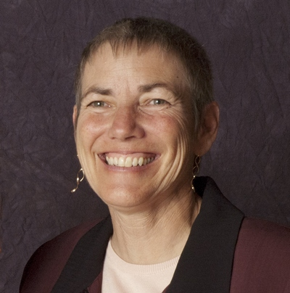
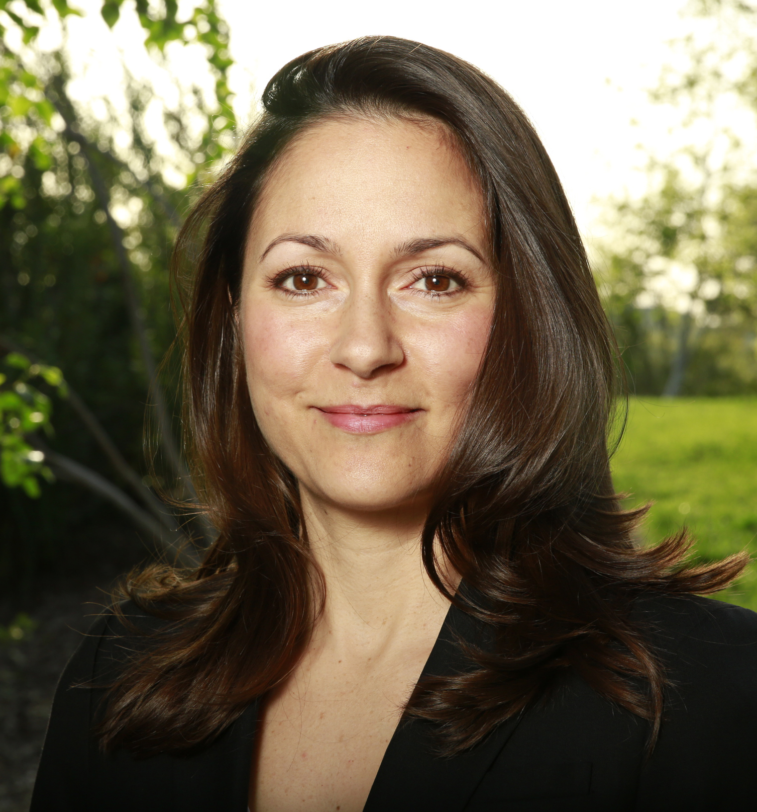
Instructors
Lori Palmquist: CID, CIC, CLIA, CLWM, QWEL, WWLP, Irrigation educator, designer and consultant
Lisa Cuellar: QWEL, Permaculture certified, M.S. Civil Engineering (Water Resources), Program Manager, CalWEP
Lunch and QWEL Reference Manuals provided at the class.
What does QWEL offer?
QWEL is recognized as a WaterSense® labeled Professional Certification Program.
The training focuses on water-saving sustainable landscaping techniques.
A sample of topics covered include: Soils, Landscape Water, Water Budgets, Irrigation Scheduling and Site Irrigation Auditing.
Those who become QWEL certified by passing the exam and completing the irrigation audit, will be listed as an industry pro on the QWEL website.
Who should attend?
This class was designed for those working in the landscape and water industries including but not limited to: landscape designers, landscape supervisors, maintenance and irrigation technicians, and park maintenance staff.

